Slide 1

Digital Twin in marine systems

Slide 2
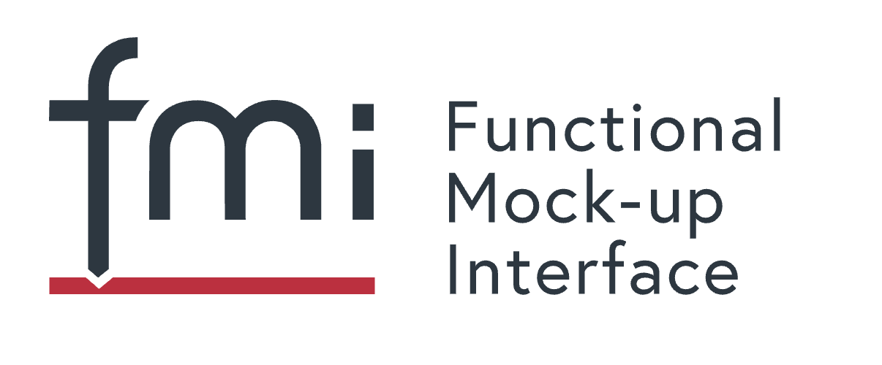
Functional Mockup Interface
The Functional Mock-up Interface (or FMI) defines a standardized interface to be used in computer simulations to develop complex cyber-physical systems.
https://fmi-standard.org/

Slide 3
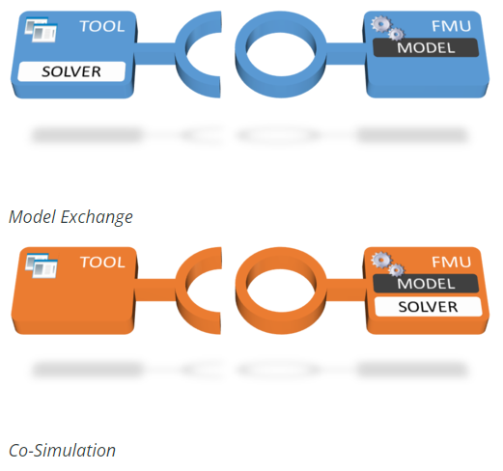
Functional Mockup Interface
When you simulate a CS FMU, the numerical solver is embedded and supplied by the exporting tool. The importing tool will set the inputs, tell the FMU to step forward a given time, and then read the outputs.
When you simulate an ME FMU, the numerical solver is supplied by the importing tool. The FMU provides functions to set the state and inputs, and to compute the state derivatives (i.e., the left hand side of the equation). The solver in the importing tool will determine what time steps to use, and how to compute the state at the next time step.

Slide 4
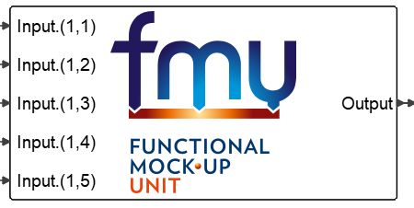
Functional Mockup Interface
AMESIM allows FMU import and export

Slide 5
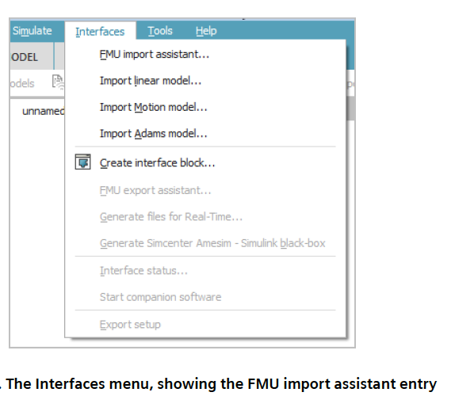
Functional Mockup Interface
AMESIM FMU import

Slide 6
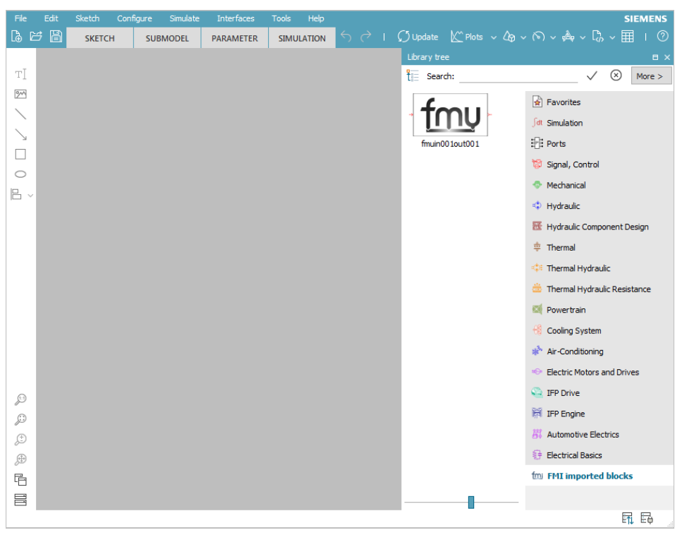
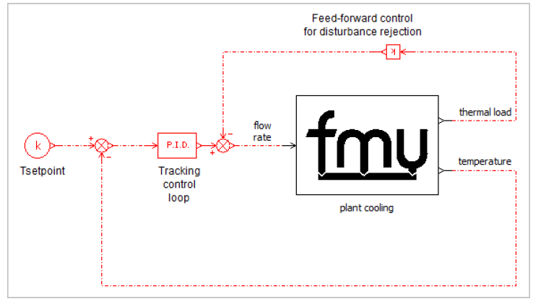
Functional Mockup Interface
AMESIM FMU import

Slide 7
Functional Mockup Interface
AMESIM FMU import

Slide 8
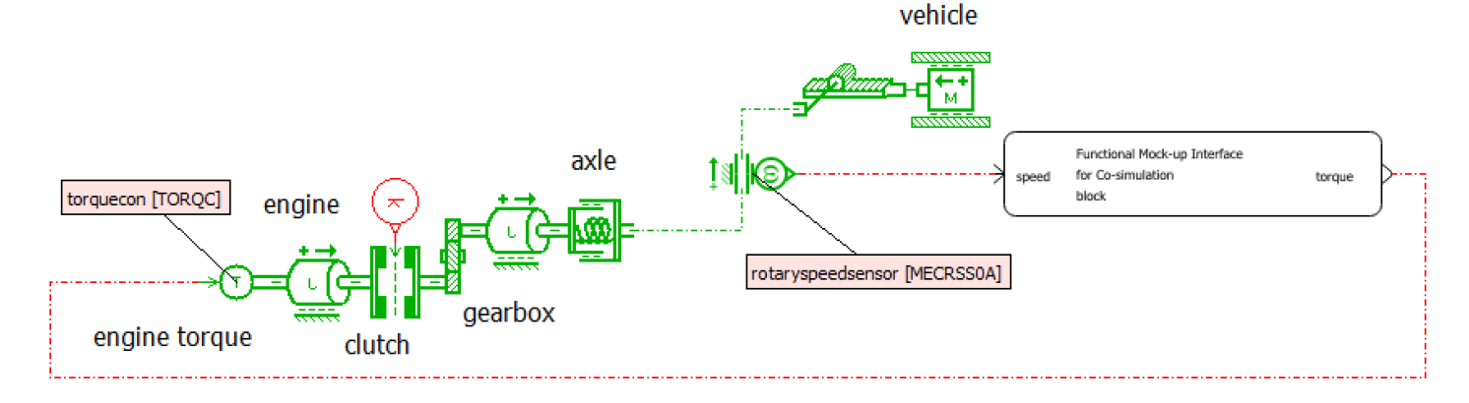
Functional Mockup Interface
AMESIM FMU export. Example.

Slide 9
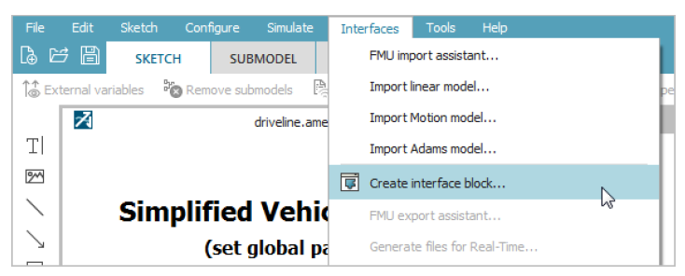
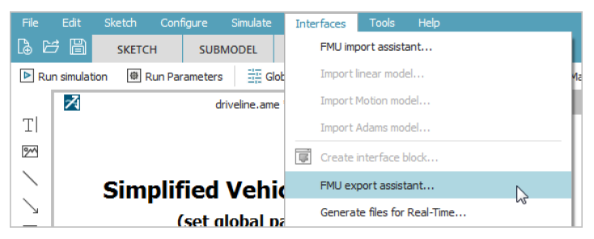
Functional Mockup Interface
AMESIM FMU export

Slide 10
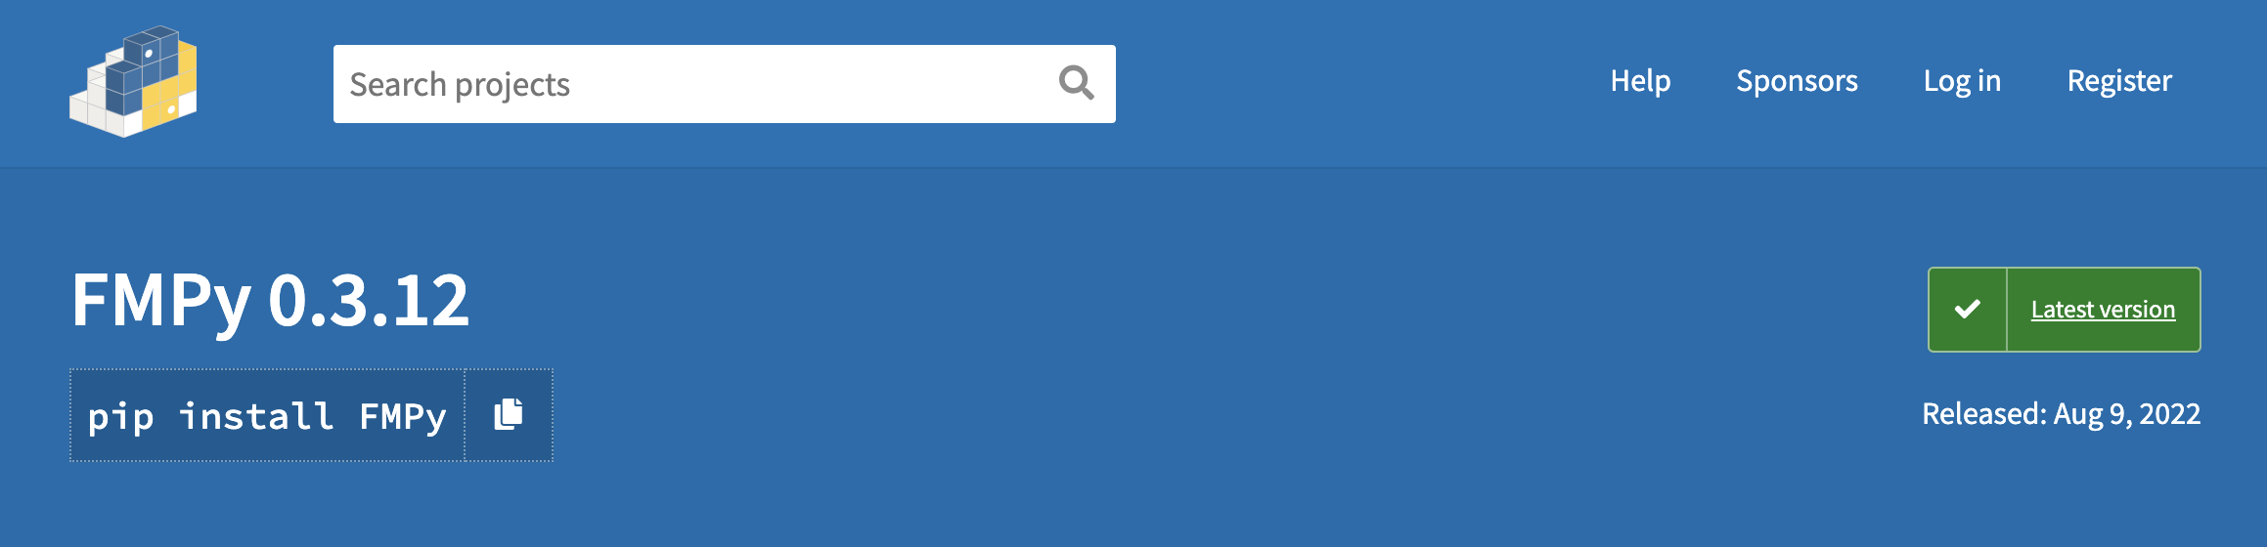
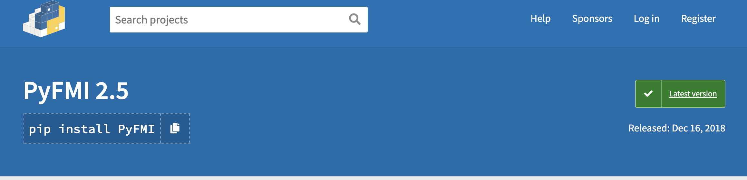
Functional Mockup Interface
Python libraries for FMU
Notes:
https://code.visualstudio.com/docs/?dv=win64user

Slide 11
Functional Mockup Interface
FMPy:
https://github.com/CATIA-Systems/FMPy/tree/1a2dc49ff786e35ffac49f32ce30fe65c5951847
Install FMPy:
https://github.com/CATIA-Systems/FMPy/blob/main/docs/install.md

